Slide 1
Main Title

Slide 3
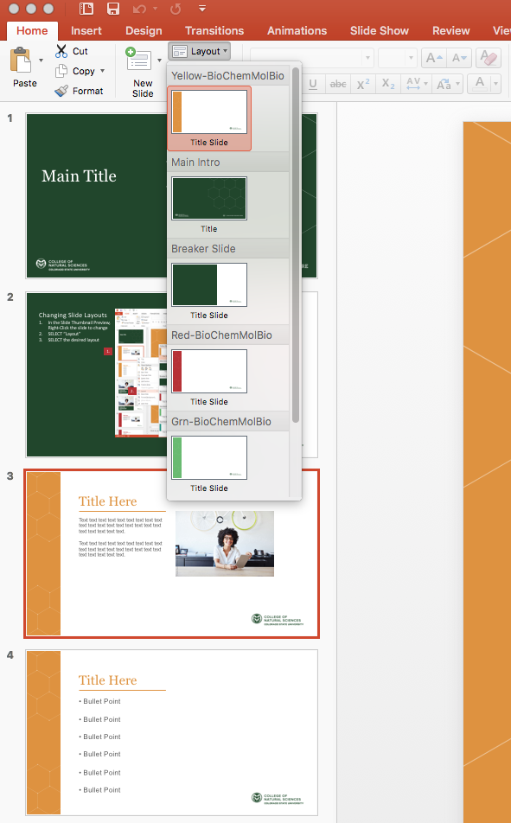
Changing Slide Layouts
For PC/Mac
In the Slide Thumbnail Preview, Select the slide to change
From the Home Tab, SELECT the Layout Button
SELECT the desired layout
2.
3.
1.

Slide 4

Title Here
Text text text text text text text text text text text text text text text text text text text text text text text.
Text text text text text text text text text text text text text text text text text text text text text text text.

Slide 5

Title Here
• Bullet Point
• Bullet Point
• Bullet Point
• Bullet Point
• Bullet Point
• Bullet Point

Slide 6
Breaker Slide
Text text text text text text text text text text text text text text text text text text text text text text text.

Slide 7
• Bullet Point
• Bullet Point
• Bullet Point
• Bullet Point
• Bullet Point
• Bullet Point
Breaker Slide
Text text text text text text text text text text text text text text text text text text text text text text text.

Slide 8
Title Here
Text text text text text text text text text text text text text text text text text text text text text text text.
Text text text text text text text text text text text text text text text text text text text text text text text.

Slide 9
Title Here
• Bullet Point
• Bullet Point
• Bullet Point
• Bullet Point
• Bullet Point
• Bullet Point

Slide 10
Title Here
Text text text text text text text text text text text text text text text text text text text text text text text.
Text text text text text text text text text text text text text text text text text text text text text text text.

Slide 11
Title Here
• Bullet Point
• Bullet Point
• Bullet Point
• Bullet Point
• Bullet Point
• Bullet Point

Slide 12
Title Here
Text text text text text text text text text text text text text text text text text text text text text text text.
Text text text text text text text text text text text text text text text text text text text text text text text.

Slide 13
Title Here
• Bullet Point
• Bullet Point
• Bullet Point
• Bullet Point
• Bullet Point
• Bullet Point

